Slide 1
Modern Education Society’s
Wadia College of Engineering, Pune
BE Project Group No. 54
Group members :
Satyam Vhora, BE-I (F20111035)
Pratik Kshirsagar, BE-I (F20111027)
Abhishek Musale, BE-I (F20111056)
Guided by : Prof.S.S.Raksar ma’am

Slide 2
Index
Software Requirement Specification
Data Flow Diagrams
ER diagrams
UML diagrams
System Implementation Plan

Slide 3
SOFTWARE REQUIREMENT SPECIFICATION

Slide 4
Hardware Requirements
AR-Ready Device : Supported devices include smartphones, tablets, and AR glasses. Must have AR capabilities for tracking and rendering.
Processor : A multi-core processor (e.g., quad-core) for handling AR rendering and interactions.
Memory (RAM) : A minimum of 8GB RAM is required for smooth performance, but higher is recommended for complex simulations.
Storage : Adequate storage space (at least 32GB) for the application and content.
Sensors : High-quality camera for object recognition and tracking.
Battery Life : Optimization for conserving battery life, as AR can be resource-intensive.

Slide 5
Software Requirements
Development Environment:
Integrated Development Environment (IDE): Popular choices include Unity 3D, Unreal Engine, or ARKit/ARCore for mobile development.
Code Editors: Text editors like Visual Studio Code for scripting and coding tasks.
AR SDKs (Software Development Kits):
ARKit (for iOS development)
ARCore (for Android development)
Vuforia (for cross-platform AR development)
AR Foundation (for Unity development)
Operating System : Supported OS (e.g., Android, iOS, or specific AR platforms like HoloLens OS).

Slide 6
Software Requirements
3D Modeling and Animation Software : Software such as Blender, Autodesk Maya, or 3ds Max to create 3D models and animations for AR objects.
Version Control : Tools like Git and GitHub for source code management and collaboration.
Backend and Server Components : Web servers or cloud services for hosting data, user profiles, and tracking progress.
Database Management System : Database software like MySQL, MongoDB, or NoSQL for storing user data, progress, and content.
Web Technologies : If our application integrates with a web component (e.g., user profiles), we might need HTML, CSS, JavaScript, and web frameworks like React or Angular.

Slide 7
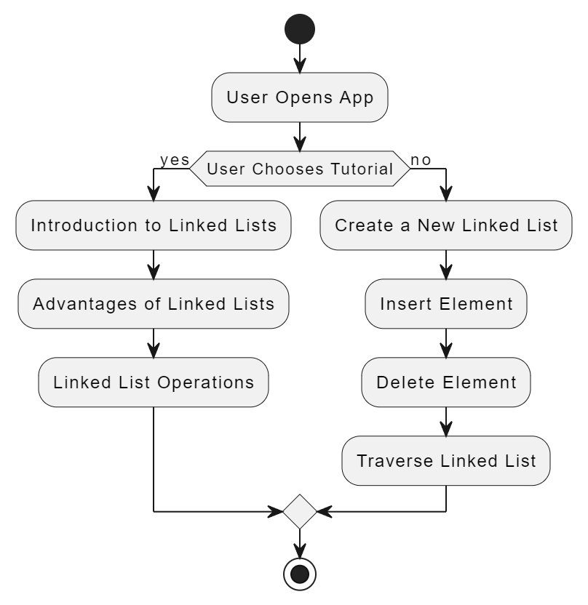
Data Flow Diagram

Slide 8
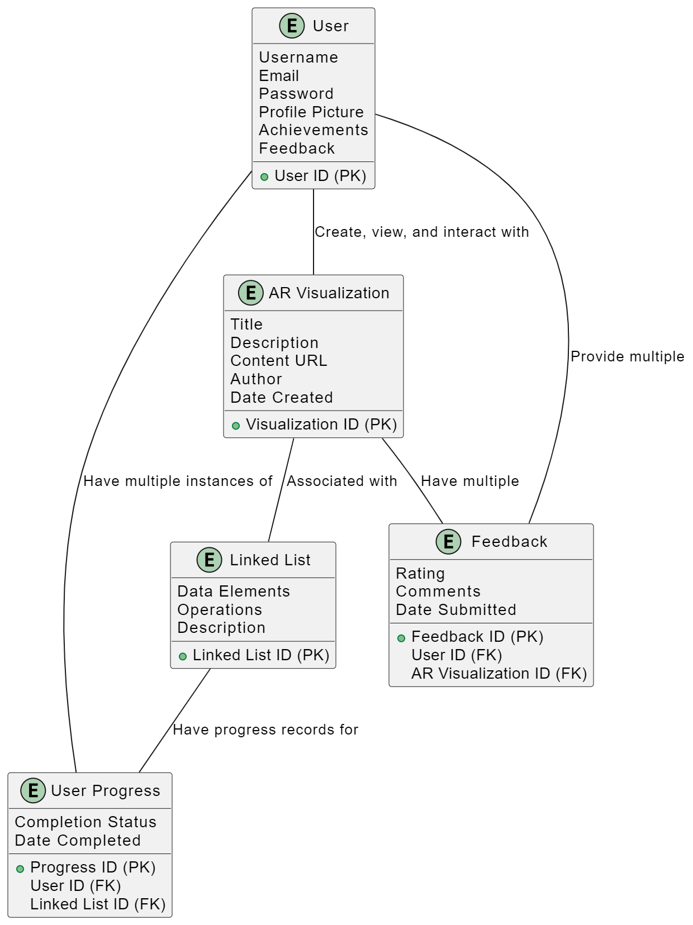
ER Diagram

Slide 9
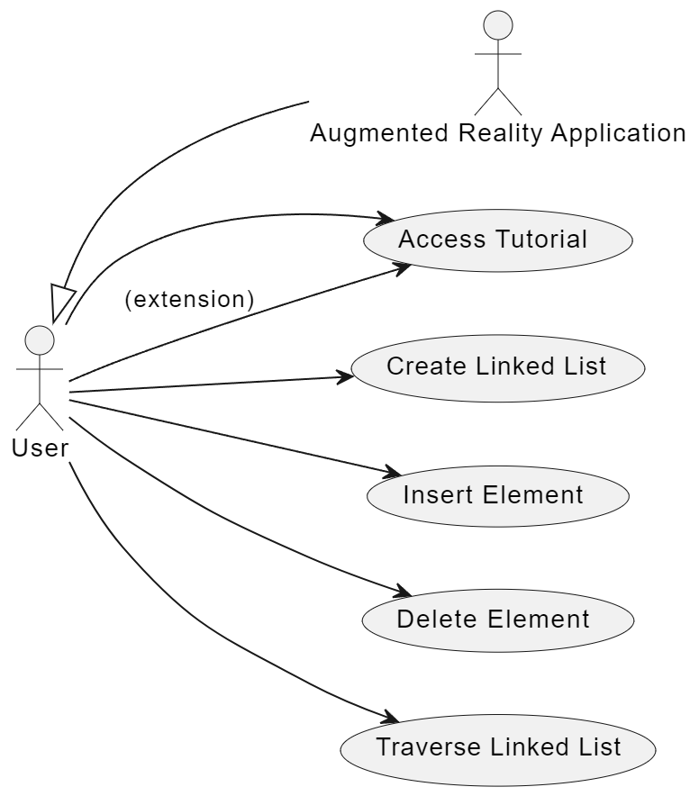
Use Case Diagram

Slide 10
SYSTEM IMPLEMENTATION PLAN

Slide 11
PROJECT TIMELINE
TASK | TIME ESTIMATE | OBJECTIVE
1. Project Initiation | 1 week | Define the project scope, goals, and roles of team members.
2. Technology Research and Selection | 2-3 week | Research and select the appropriate AR technology stack, development tools, and third-party libraries based on project requirements.
3. Software Requirements Gathering | 1-2 week | Collect, analyze, and document the software requirements to ensure a clear understanding of the application's functionality and features.
4. Hardware Requirements Gathering | 1-2 week | Identify and document the hardware requirements, including devices and sensors, needed to support the AR application's functionality.
5. Design and Architecture | 2-3 week | Develop the high-level system architecture and design the user interface for a seamless learning experience.

Slide 12
TASK | TIME ESTIMATE | OBJECTIVE
6. Model Development | 2-3 week | Create 3D models and animations for data structures visualization and simulations within the AR application.
7. Development | 2-3 week | Implement AR features, including object recognition and simulations. Develop backend and database for content management.
8. Testing | 3-4 week | Conduct unit, integration, and user acceptance testing to ensure the application's functionality and quality.
9. Data Collection & Preparation | 2 week | Collect and curate data related to data structures, such as text, images, and multimedia content. Prepare the data for integration into the application.
10. User Documentation | 2 week | Create user guides and tutorials for students and instructors.

Slide 13
TASK | TIME ESTIMATE | OBJECTIVE
11. Deployment | 1 week | Launch a beta version for limited user testing and gather feedback for improvements.
12. Refinement | 2-3 week | Address issues and apply feedback for an enhanced user experience.
13. Final Testing | 2 week | Ensure the application meets quality and performance standards.
14. Launch | 1 week | Submit the application to relevant app stores and commence marketing and promotion.

